Slide 1
Women’s Entrepreneurship Forum
Women entrepreneurs worldwide are transforming their entrepreneurial potential into economic and social impact of all kinds. Today we launch TESS: The new global gathering place that ignites conversations, connections and community in the women’s enterprise ecosystem. TESS engenders a broader conversation, creates collisions of smart, committed people, and provides a collegial atmosphere to learn new things.
The Program
Talks 14:00-16:00
Host: Orlaith Carmody, Managing Director, MediaTraining.ie
Learn from global leaders in the women’s Entrepreneurship ecosystem as they share insights on research, education, policy and practice in short compelling presentations. Engage in interactive discussion with the experts during post-talk Q&A.
Jean O’Sullivan: Manager Female Entrepreneurship, Enterprise Ireland
Paula Fitzsimons, National Director, Going for Growth
Chaewon Lee, Associate Professor, Seoul National University of Science and Technology
Nicola Byrne, CEO, 11890 Directory Enquiries and Cloud90
Entrepreneur Expert Roundtables 16:00-17:00
Host: Maura McAdam, Ph.D. Queens University, Belfast and author: Female Entrepreneurship
Women entrepreneurs and all participants are invited to engage with experts on the topics that matter most to them: managing and leading a thriving enterprise.
Microfinance Ireland: What you need to know: Lorna Coleman, Microfinance Ireland
Top Tips for Maximizing Your Team: Caroline McEnery, The HR SUITE
Developing Your Board: Deirdre Smith, Green Point Consultancy
Accelerator Options: Why not you?: Sarah O'Farrell and Amy Neale, NDRC
Social Media for Your Growing Enterprise: Oonagh McCutcheon, Elucidate
Opportunities in Women’s E’ship Research: Donna Kelley, Babson College
Community Reception and Recognition Awards 17:20-18:00
Host: Susan Duffy, Ph.D. Babson College Center for Women’s Entrepreneurial Leadership
Speaker: Bonnie Harvey, Co-founder Barefoot Wines and Co-author of The Barefoot Spirit.
The afternoon concludes with a wine and cheese reception where local and global leaders from the women’s entrepreneurship ecosystem will celebrate collective achievements and continue plans for high impact collaborations.
TESS: Diminutive of Theresa. The meaning is derived from Greek θεριζω (therizo) "to harvest."

Slide 2
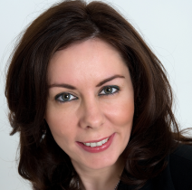
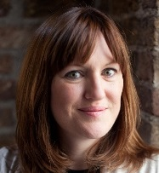
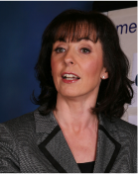
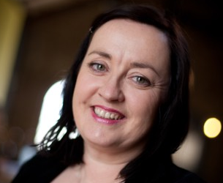
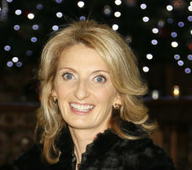
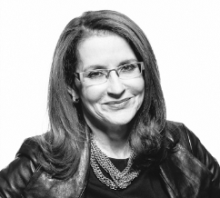
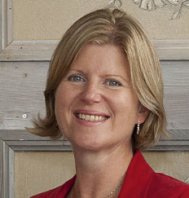
Amy Neale is Director of Communications at NDRC, and is currently leading the Female Founders at NDRC initiative in partnership with AIB and Enterprise Ireland. Amy advises and supports our partner ventures on marketing and communications strategies and activities, specializing in technology and investment marketing. Before arriving in Ireland in 2008, Amy led the business development team at Queen Mary, University of London. Amy completed her PhD in Linguistics and Computational Linguistics at Cardiff University, and she is particularly focused on opportunities relating to her own research work in the area of natural language processing and semantics.
Nicola Byrne, Founder and CEO of Cloud90, Call 11890 Directory Enquiries and Stenics Media Ltd, Board member of the Ireland US Council, Board Member British Irish Chamber of Commerce, Chairperson of the Ulster Bank Business Achievers Awards 2011/12, an Ambassador in Europe for Female Entrepreneurship, Member of DCU Ryan Academy For Entrepreneurship Advisory Board and Member Fingal County Enterprise Board Evaluation Committee.
Nicola Byrne
Amy Neale
Orlaith Carmody is Managing Director of Mediatraining.ie, a consultancy specializing in communications training and leadership development. In demand as a keynote speaker, conference chair and seminar leader, Orlaith has addressed some of Ireland’s most influential business people, networks and political groups on the subjects of professional development and corporate leadership. She has also presented at conferences in Europe, the USA and Canada. She is an active media and business commentator, and contributes regularly to a variety of radio and TV programs and publications.
As Community Co-ordinator at NDRC, Sarah is responsible for community engagement with the investment programme cohorts and alumni. Sarah works closely with the Director of Communications in delivering NDRC's communications strategy and supporting events. She also works with Director of NDRC LaunchPad, on the investment programme sourcing team. A frequent networker in Dublin’s tech startup scene, Sarah was instrumental in bringing Rails Girls to Dublin in 2012, a worldwide movement that aims to provide tools and a community for women to understand technology and to build their ideas.
Orlaith Carmody
Sarah O’Farrell
As Manager of Female Entrepreneurship, Jean manages Enterprise Irelands key initiatives to support Female Entrepreneurs. These initiatives are part of a drive to boost the number of innovative, export-oriented businesses being set up and led by female entrepreneurs. Jean has worked for Enterprise Ireland since 1999 in various roles, which include Industrial relations, Human Resource Specialist, Manager of HR Services and most recently as Senior Development Advisor with the High Potential Start up Team. Jean’s previous work experience ranged across included roles at Bank of Scotland, ANZ bank and Bank of Ireland. Jean has studied extensively in Universities abroad including; Edinburgh’s Napier University, Melbourne’s Royal Melbourne Institute of Technology and America’s Idaho State University from which she holds a BA in International Marketing. Jean also holds an MBS in Strategic Human Resources from Dublin City University.
Lorna spent many years as a self-employed training consultant working with SMEs, business start-ups, and enterprise development agencies in Ireland and the USA.
Now working fulltime with Microfinance Ireland, she manages the stakeholder relationship and business development functions. Lorna is a graduate of Dublin City University with a M.Sc. in Education Management. She has many years’ experience of working in the Microfinance area. She served as a Board member of the European Microfinance Network in Paris from 2005 to 2007.
Lorna Coleman
Jean O’Sullivan
Susan Duffy is the Executive Director of the Babson College Center for Women’s Entrepreneurial Leadership (CWEL), where she educates, inspires and empowers women to transform their entrepreneurial potential into entrepreneurial impact. CWEL’s latest innovation is the Women Innovating Now (WIN) Lab that accelerates women who are ready to think big, be bold, and launch successful companies. Susan earned her Ph.D. from The George Washington University where she founded the Women’s Entrepreneurial Leadership initiative, a program recognized as the 2006 National Model Specialty Program in Entrepreneurship Education. Before entering academia Susan was a leader in healthcare foodservice, co-owned a commercial construction company, and owned and operated Ho-Lee-Chow, a Chinese fast-food franchise. Susan is an advisor to several early stage companies and is an angel investor. She serves on the boards of the Tory Burch Foundation and the International Council for Small Business where she chairs the Global Women’s Entrepreneurship Committee.
Deirdre Smith is a Chartered Director, holds several board positions, and acts as a consultant, mentor and advisor to start-up companies and SMEs, both through Enterprise Ireland and Green Point Consultancy. She is also a Lead Entrepreneur with Going for Growth, an EU supported initiative to help female entrepreneurs grow their businesses. She was the CEO of Zandar Technologies plc, which developed award winning broadcast video solutions until their acquisition by a US multi-national corporation in 2007.
Susan Duffy
Deirdre Smith

Slide 3
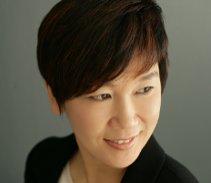
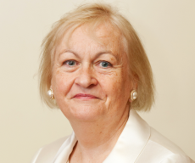
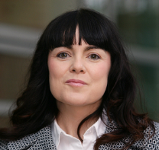
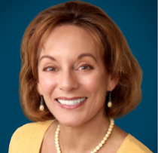
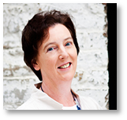
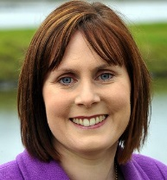
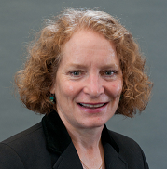
Chaewon Lee is an Associate Professor of Department of Business Administration and a Division Chair. Also she was a director of Entrepreneurship Education Center at Seoul National University of Science and Technology, Seoul, South Korea. She received her Ph.D in Strategic Management from Kyungpook National University. Also, she worked at Babson College for two and half years as a visiting scholar. Her research has been published in the Journal of Small Business Management, Journal of Product Innovation Management, and R&D Management. Her current research focuses on innovation and entrepreneurship in new ventures and established organizations in the U.S. and Korea. She teaches strategic management, corporate entrepreneurship, and entrepreneurship and new venture creation at Seoul National University of Science and Technology.
Paula Fitzsimons is the founder and managing director of Fitzsimons Consulting, which specialises in areas related to entrepreneurship and growth. A recognised expert on entrepreneurship, Paula Fitzsimons has been the national coordinator of GEM for Ireland since 2000.
Building on the findings of GEM research that fewer women start new businesses and of those that start, fewer have significant growth ambitions than do men, Paula designed and developed Going for Growth goingforgrowth.com. Now in its 6th cycle, Going for Growth has supported over 300 women entrepreneurs to achieve their growth ambitions and measures its success in terms of the participants’ increased turnover, additional employment created and the number of new exporters. Since its pilot in 2008, the initiative has been selected on many occasions as good practice. In 2014 alone, it has received accolades from the EU and OECD, and most recently from the European Institute of Gender Equality.
Paula also drew on GEM research in the design and development of Senior Enterprise. This initiative seeks to increase the engagement of those in the older age group with entrepreneurship and with enterprise more generally (seniorenterprise.ie). In November 2013, Senior Enterprise won a European Enterprise Award 2013 in the “Investing in Skills” category.
Chaewon Lee
Maura’s research interests include: the start-up patterns of new ventures in emerging technologies within the incubator environment, with a particular focus on entrepreneurial networking; the interaction between gender and high technology start-ups and, copreneurship and family business. Within these fields, Maura has presented her work on a national and international basis and has published in several international journals including Entrepreneurship, Theory and Practice, Entrepreneurship and Regional Development and R&D Management. Maura also recently authored a book with Routledge entitled ‘Female Entrepreneurship’. Maura is an Editorial Board Member of the International Small Business Journal (ISBJ), where she has held positions of Guest Editor and Invited Editor. In addition, Maura is an invited Fellow of the Royal Society of Arts (FRSA).
Paula Fitzsimons
Maura McAdam
Bonnie was the Co-Founder and VP of Barefoot Cellars for 20 years and is the co-author of The New York Times Bestselling book, The Barefoot Spirit; How Hardship, Hustle, and Heart Built America's #1 Wine Brand. Barefoot Cellars won several awards, including Fast Track Growth Brand, Trend Setter, and Hot Brand, all without paid advertising. Bonnie is the recipient of the 2014 Distinguished Entrepreneur Speaker Award from the Turner School of Entrepreneurship and Innovation at Bradley University, and keynote speaker at the World Conference on Entrepreneurship in Dublin. She enjoys helping entrepreneurs understand business philosophy, the intricacies of building and growing a business, advertising and marketing, and building team spirit. She co-authors weekly business blogs at: thebarefootspirit.com and thebrandauthority.net.
A highly experienced senior manager with an operations and business development background. She has worked extensively with organisations to maximise the web as a primary communications channel. The clients she works with include An Post, Fáilte Ireland, Eircom Phonewatch, NSAI, GeoDirectory, IE Domain Registry, Waterford Technologies, UCD, The Royal Institute of Architects in Ireland (RIAI). Oonagh also has extensive experience of working directly with SMEs. In 2013 with her business partner, Maeve Kneafsey, she co-founded Marketfinder. Here they have developed software that turns website visitors into customers. Prior to joining Elucidate, Oonagh worked as Head of Operations for Transware (now WeLocalize) a leading eLearning localisation company.
Oonagh McCutcheon
Bonnie Harvey
Caroline McEnery, Founder and Managing Director of The HR Suite, has a Masters in Human Resource Management from the University of Limerick. Caroline is CIPD (Chartered Institute of Personnel and Development) accredited and is also a certified member of the Mediators’ Institute of Ireland. She has over 15 years’ of HR experience from her work with the Garvey Group (SuperValu supermarkets) and the Kerry Group, prior to setting up her own business in 2009. Formerly known as ‘HR & Business Solutions’, The HR Suite is a full-service HR consultancy that offers outsourced advice, business consultancy and training to companies and brands all over Ireland. Headquartered in Tralee, Co. Kerry, the company employs 8 HR professionals with Excellence Through People (Gold Level) accreditation.
Donna Kelley is a Professor of Entrepreneurship at Babson College, and holds the Frederic C. Hamilton Chair of Free Enterprise. Prof. Kelley’s research has been published in top entrepreneurship and innovation journals. She is a board member of the Global Entrepreneurship Research Association (GERA), the oversight board of the Global Entrepreneurship Monitor (GEM), and leader of the GEM U.S. team. She has co-authored GEM reports on global entrepreneurship, women’s entrepreneurship, entrepreneurship education and training, and entrepreneurship in the U.S., Korea, and Africa. Besides teaching a variety of entrepreneurship courses at Babson College, Prof. Kelley has taught seminars and courses at top universities in China and Korea, and worked in Bandung, Indonesia as a Fulbright Specialist.
Caroline McEnery
Donna Kelley

